Slide 1
Hashing, Hash Functions, Hash Tables
0
∅
1
025-612-0001
2
981-101-0002
3
∅
4
451-229-0004

Slide 2
Recall the Map ADT
get(k): if the map M has an entry with key k, return its associated value; else, return null
put(k, v): insert entry (k, v) into the map M; if key k is not already in M, then return null; else, return old value associated with k
remove(k): if the map M has an entry with key k, remove it from M and return its associated value; else, return null
size(), isEmpty()
entrySet(): return an iterable collection of the entries in M
keySet(): return an iterable collection of the keys in M
values(): return an iterator of the values in M

Slide 3

Intuitive Notion of a Map
Intuitively, a map M supports the abstraction of using keys as indices with a syntax such as M[k].
As a warm-up, consider a restricted setting in which a map with n items uses keys that are known to be integers in a range from 0 to N − 1, for some N ≥ n.

Slide 4
More General Kinds of Keys
But what should we do if our keys are not integers in the range from 0 to N – 1?
Use a hash function to map general keys to corresponding indices in a table.
For instance, the last four digits of a Social Security number.
0
∅
1
025-612-0001
2
981-101-0002
3
∅
4
451-229-0004
…

Slide 5
Suppose we want to design a system for storing employee records keyed using phone numbers. And, we want following queries to be performed efficiently:
Insert a phone number and corresponding information.
Search a phone number and fetch the information.
Delete a phone number and related information.
We can think of using the following data structures to maintain information about different phone numbers.
Array of phone numbers and records.
Linked List of phone numbers and records.
Balanced binary search tree with phone numbers as keys.
Direct Access Table.

Slide 6
For arrays and linked lists, we need to search in a linear fashion, which can be costly in practice. If we use arrays and keep the data sorted, then a phone number can be searched in O(Logn) time using Binary Search, but insert and delete operations become costly as we have to maintain sorted order.
With balanced binary search tree, we get moderate search, insert and delete times. All of these operations can be guaranteed to be in O(Logn) time.
Another solution that one can think of is to use a direct access table where we make a big array and use phone numbers as index in the array.
An entry in array is NIL if phone number is not present, else the array entry stores pointer to records corresponding to phone number. Time complexity wise this solution is the best among all, we can do all operations in O(1) time.

Slide 7
For example to insert a phone number, we create a record with details of given phone number, use phone number as index and store the pointer to the created record in table. This solution has many practical limitations. First problem with this solution is extra space required is huge. For example if phone number is n digits, we need O(m * 10^{n}) space for table where m is size of a pointer to record. Another problem is an integer in a programming language may not store n digits.
Due to above limitations Direct Access Table cannot always be used. Hashing is the solution that can be used in almost all such situations and performs extremely well compared to above data structures like Array, Linked List, Balanced BST in practice. With hashing we get O(1) search time on average (under reasonable assumptions) and O(n) in worst case.

Slide 8
Hashing is an improvement over Direct Access Table. The idea is to use hash function that converts a given phone number or any other key to a smaller number and uses the small number as index in a table called hash table.
Hash Function: A function that converts a given big phone number to a small practical integer value.
The mapped integer value is used as an index in hash table.
In simple terms, a hash function maps a big number or string to a small integer that can be used as index in hash table.

Slide 9
A good hash function should have following properties 1) Efficiently computable. 2) Should uniformly distribute the keys (Each table position equally likely for each key)
For example for phone numbers a bad hash function is to take first three digits. A better function is consider last three digits.
Please note that this may not be the best hash function. There may be better ways.
Hash Table: An array that stores pointers to records corresponding to a given phone number. An entry in hash table is NIL if no existing phone number has hash function value equal to the index for the entry.

Slide 10
Collision Handling: Since a hash function gets us a small number for a big key, there is possibility that two keys result in same value. The situation where a newly inserted key maps to an already occupied slot in hash table is called collision and must be handled using some collision handling technique. Following are the ways to handle collisions:
Chaining: The idea is to make each cell of hash table point to a linked list of records that have same hash function value. Chaining is simple, but requires additional memory outside the table.
Open Addressing: In open addressing, all elements are stored in the hash table itself. Each table entry contains either a record or NIL. When searching for an element, we one by one examine table slots until the desired element is found or it is clear that the element is not in the table.

Slide 11
Hashing
Hashing is a technique that is used to uniquely identify a specific object from a group of similar objects. Some examples of how hashing is used in our lives include:
In universities, each student is assigned a unique roll number that can be used to retrieve information about them.
In libraries, each book is assigned a unique number that can be used to determine information about the book, such as its exact position in the library or the users it has been issued to etc.
In both these examples the students and books were hashed to a unique number.

Slide 12
Assume that you have an object and you want to assign a key to it to make searching easy.
To store the key/value pair, you can use a simple array like a data structure where keys (integers) can be used directly as an index to store values. However, in cases where the keys are large and cannot be used directly as an index, you should use hashing.
In hashing, large keys are converted into small keys by using hash functions. The values are then stored in a data structure called hash table.
The idea of hashing is to distribute entries (key/value pairs) uniformly across an array. Each element is assigned a key (converted key). By using that key you can access the element in O(1) time.

Slide 13
Using the key, the algorithm (hash function) computes an index that suggests where an entry can be found or inserted.
Hashing is implemented in two steps:
An element is converted into an integer by using a hash function. This element can be used as an index to store the original element, which falls into the hash table.
The element is stored in the hash table where it can be quickly retrieved using hashed key.
hash = hashfunc(key) index = hash % array_size
In this method, the hash is independent of the array size and it is then reduced to an index (a number between 0 and array_size − 1) by using the modulo operator (%).

Slide 14
Hash Table
A hash table is a collection of items which are stored in such a way as to make it easy to find them later.
Each position of the hash table, often called a slot, can hold an item and is named by an integer value starting at 0.
For example, we have a hash table of size m=11. In other words, there are m slots in the table, named 0 through 10.
Initially, the hash table contains no items so every slot is empty.
We can implement a hash table by using a list with each element initialized to the special value None.

Slide 15
Hash Function
The mapping between an item and the slot where that item belongs in the hash table is called the hash function.
The hash function will take any item in the collection and return an integer in the range of slot names, between 0 and m-1.

Slide 16
Hash Functions and Hash Tables
A hash function h maps keys of a given type to integers in a fixed interval [0, N - 1]
Example: h(x) = x mod N is a hash function for integer keys
The integer h(x) is called the hash value of key x
A hash table is a data structure that is used to store keys/value pairs.
A hash table for a given key type consists of
Hash function h
Array (called table) of size N
When implementing a map with a hash table, the goal is to store item (k, o) at index i = h(k)

Slide 17
Example
We design a hash table for a map storing entries as (SSN, Name), where SSN (social security number) is a nine-digit positive integer
Our hash table uses an array of size N = 10,000 and the hash function h(x) = last four digits of x
0
∅
1
025-612-0001
2
981-101-0002
3
∅
4
451-229-0004
…
9997
∅
9998
200-751-9998
9999
∅

Slide 18
Hash Functions
A hash function is usually specified as the composition of two functions:
Hash code: h₁: keys → integers
Compression function: h₂: integers → [0, N - 1]
The hash code is applied first, and the compression function is applied next on the result, i.e., h(x) = h₂(h₁(x))
The goal of the hash function is to “disperse” the keys in an apparently random way

Slide 19
Hash Codes
Component sum:
We partition the bits of the key into components of fixed length (e.g., 16 or 32 bits) and we sum the components (ignoring overflows)
Suitable for numeric keys of fixed length greater than or equal to the number of bits of the integer type (e.g., long and double in Java)
Memory address:
We reinterpret the memory address of the key object as an integer (default hash code of all Java objects)
Good in general, except for numeric and string keys
Integer cast:
We reinterpret the bits of the key as an integer
Suitable for keys of length less than or equal to the number of bits of the integer type (e.g., byte, short, int and float in Java)

Slide 20
Hash Codes (cont.)
Polynomial p(z) can be evaluated in O(n) time using Horner’s rule:
The following polynomials are successively computed, each from the previous one in O(1) time
p₀(z) = a_{n-1}
p_{i} (z) = a_{n-i-1} + zp_{i-1}(z) (i = 1, 2, …, n -1)
We have p(z) = p_{n-1}(z)
Polynomial accumulation:
We partition the bits of the key into a sequence of components of fixed length (e.g., 8, 16 or 32 bits) a₀ a₁ … a_{n-1}
We evaluate the polynomial
p(z) = a₀ + a₁ z + a₂ z² + … … + a_{n-1}z^{n-1}
at a fixed value z, ignoring overflows
Especially suitable for strings (e.g., the choice z = 33 gives at most 6 collisions on a set of 50,000 English words)

Slide 21
Compression Functions
Division:
h₂ (y) = y mod N
The size N of the hash table is usually chosen to be a prime
The reason has to do with number theory and is beyond the scope of this course
Multiply, Add and Divide (MAD):
h₂ (y) = (ay + b) mod N
a and b are nonnegative integers such that a mod N ≠ 0
Otherwise, every integer would map to the same value b

Slide 22
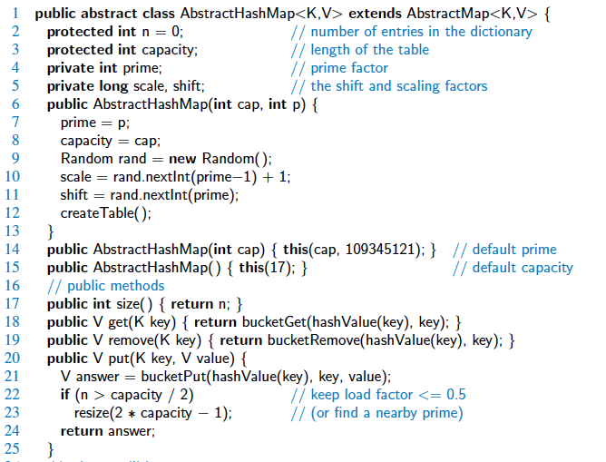
Abstract Hash Map in Java

Slide 23
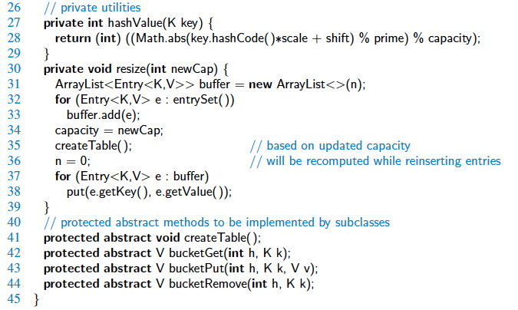
Abstract Hash Map in Java, 2

Slide 24
Collision Handling
Collisions occur when different elements are mapped to the same cell
Separate Chaining: let each cell in the table point to a linked list of entries that map there
0
∅
1
025-612-0001
2
∅
3
∅
4
451-229-0004
981-101-0004
Separate chaining is simple, but requires additional memory outside the table

Slide 25
Map with Separate Chaining
Delegate operations to a list-based map at each cell:
Algorithm get(k):
return A[h(k)].get(k)
Algorithm put(k,v):
t = A[h(k)].put(k,v)
if t = null then {k is a new key}
n = n + 1
return t
Algorithm remove(k):
t = A[h(k)].remove(k)
if t ≠ null then {k was found}
n = n - 1
return t

Slide 26
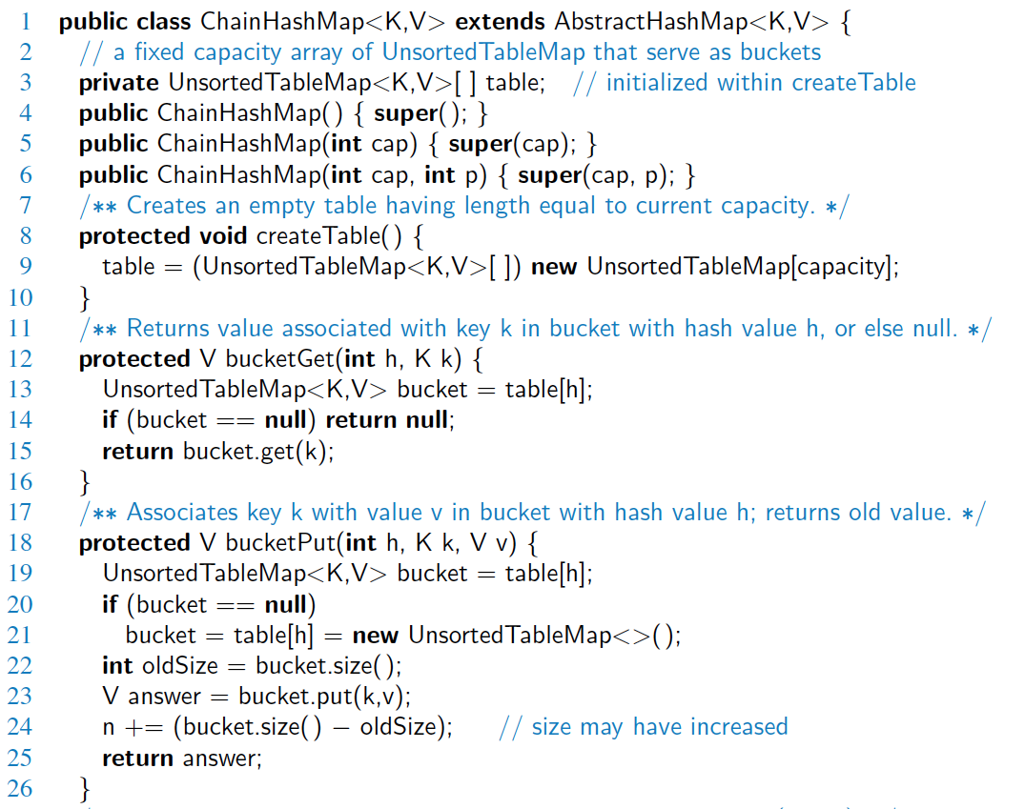
Hash Table with Chaining

Slide 27
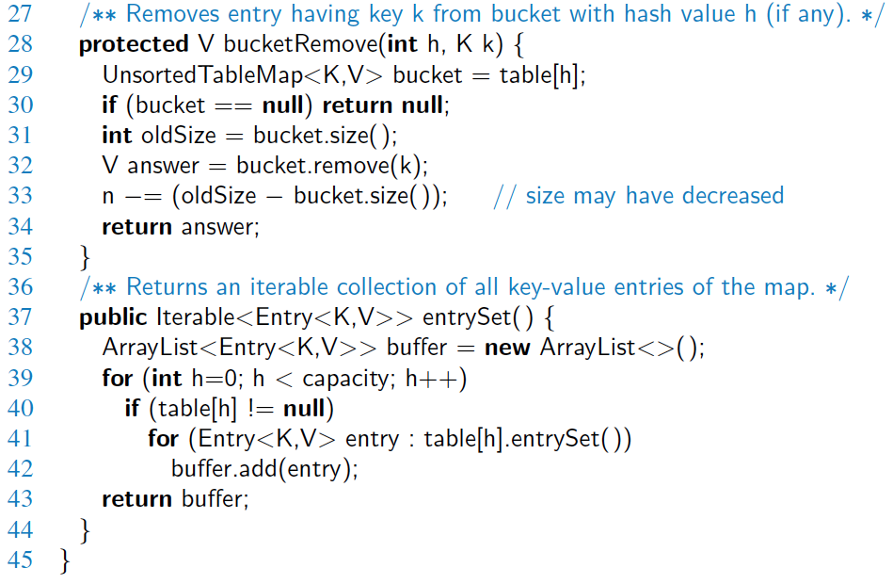
Hash Table with Chaining, 2

Slide 28
Linear Probing
Open addressing: The colliding item is placed in a different cell of the table
Linear probing: handles collisions by placing the colliding item in the next (circularly) available table cell
Each table cell inspected is referred to as a “probe”
Colliding items lump together, causing future collisions to cause a longer sequence of probes
Example:
h(x) = x mod 13
Insert keys 18, 41, 22, 44, 59, 32, 31, 73, in this order
0
1
2
3
4
5
6
7
8
9
10
11
12
41
18
44
59
32
22
31
73
0
1
2
3
4
5
6
7
8
9
10
11
12

Slide 29
Search with Linear Probing
Consider a hash table A that uses linear probing
get(k)
We start at cell h(k)
We probe consecutive locations until one of the following occurs
An item with key k is found, or
An empty cell is found, or
N cells have been unsuccessfully probed
Algorithm get(k)
i ← h(k)
p ← 0
repeat
c ← A[i]
if c = ∅
return null
else if c.getKey () = k
return c.getValue()
else
i ← (i + 1) mod N
p ← p + 1
until p = N
return null

Slide 30
Updates with Linear Probing
To handle insertions and deletions, we introduce a special object, called DEFUNCT, which replaces deleted elements
remove(k)
We search for an entry with key k
If such an entry (k, o) is found, we replace it with the special item DEFUNCT and we return element o
Else, we return null
put(k, o)
We throw an exception if the table is full
We start at cell h(k)
We probe consecutive cells until one of the following occurs
A cell i is found that is either empty or stores DEFUNCT, or
N cells have been unsuccessfully probed
We store (k, o) in cell i

Slide 31
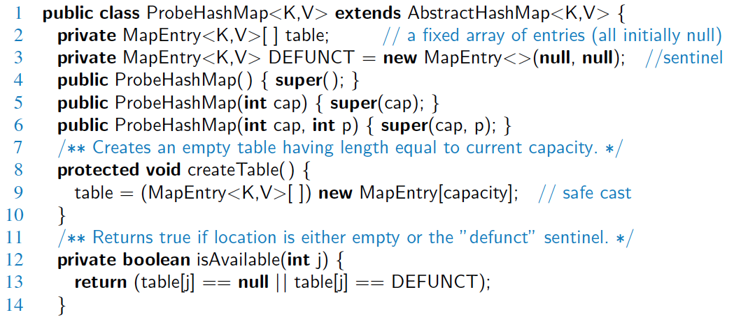
Probe Hash Map in Java

Slide 32
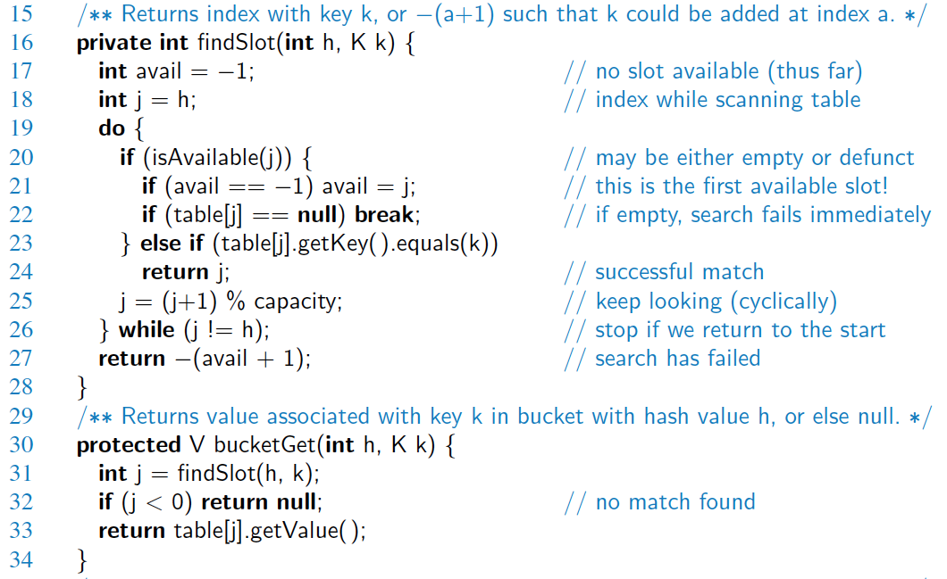
Probe Hash Map in Java, 2

Slide 33
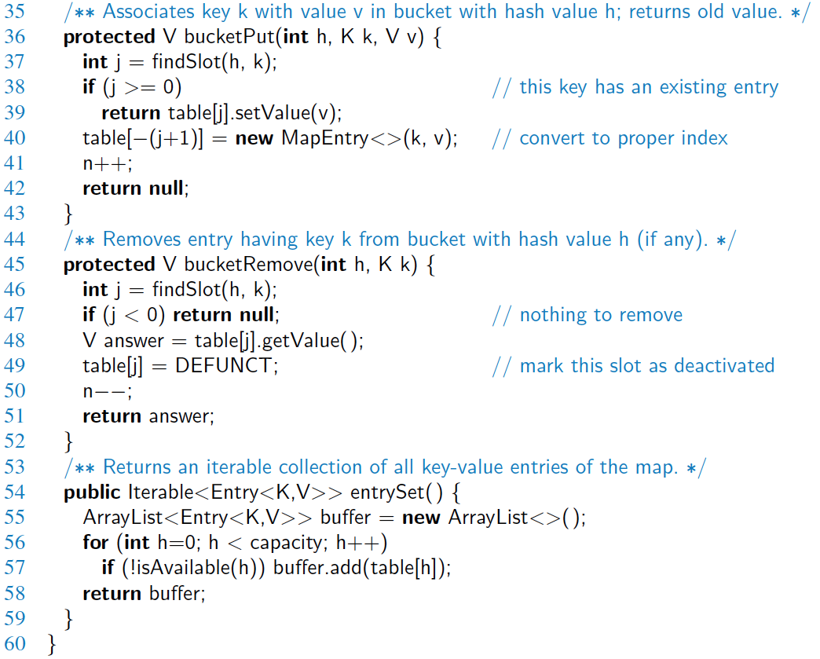
Probe Hash Map in Java, 3

Slide 34
Double Hashing
Double hashing uses a secondary hash function d(k) and handles collisions by placing an item in the first available cell of the series (i + jd(k)) mod N for j = 0, 1, … , N - 1
The secondary hash function d(k) cannot have zero values
The table size N must be a prime to allow probing of all the cells
Common choice of compression function for the secondary hash function:
d₂(k) = q - k mod q
where
q < N
q is a prime
The possible values for d₂(k) are 1, 2, … , q

Slide 35
Example of Double Hashing
Consider a hash table storing integer keys that handles collision with double hashing
N = 13
h(k) = k mod 13
d(k) = 7 - k mod 7
Insert keys 18, 41, 22, 44, 59, 32, 31, 73, in this order
0
1
2
3
4
5
6
7
8
9
10
11
12
31
41
18
32
59
73
22
44
0
1
2
3
4
5
6
7
8
9
10
11
12

Slide 36
Performance of Hashing
In the worst case, searches, insertions and removals on a hash table take O(n) time
The worst case occurs when all the keys inserted into the map collide
The load factor a = n/N affects the performance of a hash table
Assuming that the hash values are like random numbers, it can be shown that the expected number of probes for an insertion with open addressing is 1 / (1 - a)
The expected running time of all the dictionary ADT operations in a hash table is O(1)
In practice, hashing is very fast provided the load factor is not close to 100%
Applications of hash tables:
small databases
compilers
browser caches

